Slide 1
Optional in Java8+
Best practices, Dos and Don’ts
CONFIDENTIAL | © 2023 EPAM Systems, Inc.

Slide 2
Contents
What is Optional class in Java
Example
Optional class methods
Functional programming using Optional
Best practices
Examples
Functional style coding using Optional

Slide 3
What is Optional class
Average answers:
Optional class was introduced in Java 8 to handle Null Pointer Exception
Optional class was introduced to handle null values in in Java 8. It contains isPresent() and get() methods.
Best answer from Java doc:
A container object which may or may not contain a non-null value. If a value is present, isPresent() returns true. If no value is present, the object is considered empty and isPresent() returns false.
Optional is primarily intended for use as a method return type where there is a clear need to represent "no result," and where using null is likely to cause errors. A variable whose type is Optional should never itself be null; it should always point to an Optional instance.

Slide 4
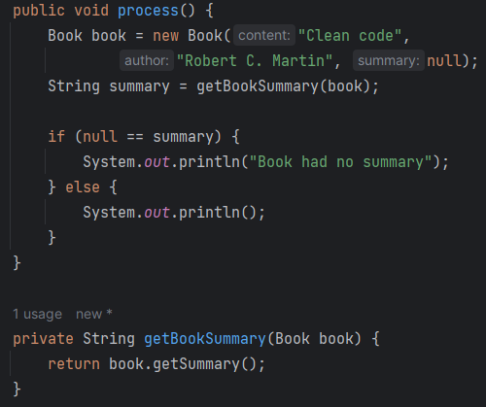
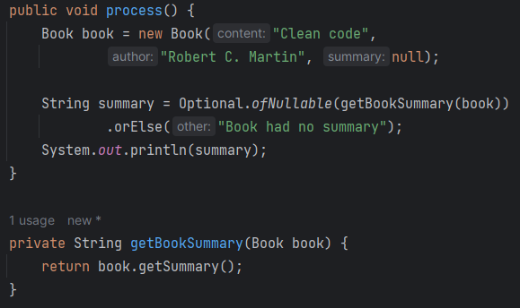
Optional example
Before Java 8
After Java 8 and Optional

Slide 5
Optional class methods
Method | Since | Description
- of() | Java 8 | Returns an Optional describing the given non-null value. E.g., Optional.of(new String("data")) returns an optional container object. Optional.of(null) throws NullPointerException.
- ofNullable() | Java 8 | Returns an Optional describing the given value, if non-null, otherwise returns an empty Optional. E.g., Optional.ofNullable(new String("data")) returns an optional container object. Optional. ofNullable(null) returns Optional.empty container object.
- empty() | Java 8 | Returns an empty Optional instance. No value is present for this Optional. E.g., Optional<Object> emptyOptional = Optional.empty();
- isEmpty() | Java 11 | If a value is not present, returns true, otherwise false. E.g., boolean isValueEmpty = emptyOptional.isEmpty();
- isPresent() | Java 8 | If a value is present, returns true, otherwise false. E.g., boolean isValuePresent = emptyOptional.isPresent();

Slide 6
Optional class methods …
Method | Since | Description
- map() | Java 8 | If a value is present, returns an Optional describing the result of applying the given mapping function to the value, otherwise returns an empty Optional. If the mapping function returns a null result, then this method returns an empty Optional. E.g., Double sqrt = Optional.ofNullable("4096") .map(Integer::valueOf) .map(Math::sqrt) .orElse(-1.0);
- flatMap() | Java 8 | If a value is present, returns the result of applying the given Optional-bearing mapping function to the value, otherwise returns an empty Optional. This method is similar to map(Function), but the mapping function is one whose result is already an Optional, and if invoked, flatMap does not wrap it within an additional Optional. E.g., Double sqrt = Optional.ofNullable("4096") .map(Integer::valueOf) .flatMap(num -> Optional.of(Math.sqrt(num))) .orElse(-1.0);
- stream() | Java 9 | If a value is present, returns a sequential Stream containing only that value, otherwise returns an empty Stream.

Slide 7
Optional class methods …
Method | Since | Description
- filter() | Java 8 | If a value is present, and the value matches the given predicate, returns an Optional describing the value, otherwise returns an empty Optional. Throws NullPointerException, if the predicate is null. E.g., int number = Optional.ofNullable("4096") .map(Integer::valueOf) .filter(num -> num % 2 == 0) .orElse(-1);
- get() | Java 8 | If a value is present, returns the value, otherwise throws NoSuchElementException. The preferred alternative to this method is orElse(), orElseThrow(). E.g., int number = Optional.ofNullable("4096") .map(Integer::valueOf) .get();
- void ifPresent (Supplier) | Java 8 | If a value is present, performs the given action with the value, otherwise does nothing. Throws NullPointerException, if value is present and the given action is null E.g., Optional.ofNullable(book.getSummary()) .ifPresent(System.out::println);

Slide 8
Optional class methods …
Method | Since | Description
- void ifPresentOrElse (Supplier, Runnable) | Java 8 | If a value is present, performs the given action with the value, otherwise performs the given empty-based action. Throws NullPointerException – if a value is present and the given action is null, or no value is present, and the given empty-based action is null. E.g., Optional.ofNullable(book.getSummary()) .ifPresentOrElse(System.out::println, () -> {throw new RuntimeException("Summary is null");});
- or(Supplier) | Java 9 | If a value is present, returns an Optional describing the value, otherwise returns an Optional produced by the supplying function. Throws NullPointerException – if the supplying function is null or produces a null result E.g., Optional.ofNullable(book.getSummary()) .or(Book::defaultSummary) .map(Book::process);
- orElse( default value) | Java 8 | If a value is present, returns the value, otherwise returns other. E.g., String summary = Optional.ofNullable(book.getSummary()) .orElse("The default summary");

Slide 9
Optional class methods …
Method | Since | Description
- orElseGet (Supplier) | Java 8 | If a value is present, returns the value, otherwise returns the result produced by the supplying function. Throws NullPointerException – if no value is present and the supplying function is null E.g., Optional.ofNullable(book.getSummary()) .orElseGet(Book::defaultSummaryValue)
-orElseThrow() | Java 10 | If a value is present, returns the value, otherwise throws NoSuchElementException. E.g., Optional.ofNullable(book.getSummary()) .orElseThrow();
-orElseThrow (exceptionSupplier) | Java 8 | If a value is present, returns the value, otherwise throws an exception produced by the exception supplying function. E.g., Optional.ofNullable(book.getSummary()) .orElseThrow(RuntimeException::new);

Slide 10
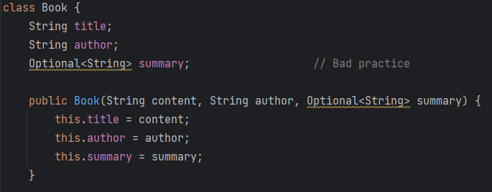
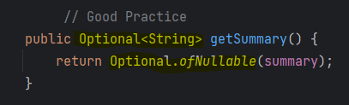
Best practices
Golden rules of Optional usage
Never create Optional class members
Never create Optional variables
Never create Optional method arguments
Optional should be limited to use in the method return type.
Why not create variables of type Optional ?
Serialization of Objects fails with exception when it contains Optional data members.
Converting Objects to JSON produces undesired results when it contains Optional data members.
Java allows these variable declarations; it doesn’t mean the code is clean.

Slide 11
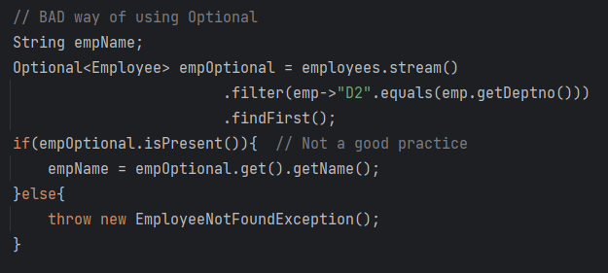
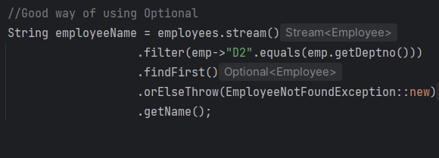
Good and Bad – use Optional.orElseThrow()

Slide 12
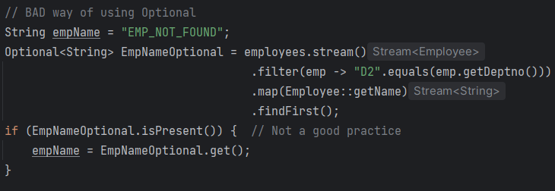
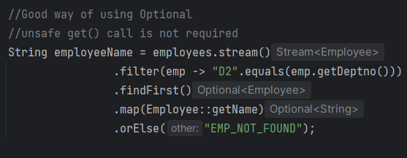
Good and Bad – use Optional.orElse()

Slide 13
Functional style coding using Optional
Before java 8 | Bad way of using Optional | Optional Functional Style
Book book = new Book(new Chapter("The Summary")); String summary = "default value"; if (book != null) { Chapter chapter = book.chapter(); if (chapter != null) { if (chapter.summary() != null) { summary = chapter.summary() .toUpperCase(); } } } | Book book = new Book(new Chapter("The Summary")); Optional<Book> bookOptional = Optional.ofNullable(book); if (bookOptional.isPresent()) { Optional<Chapter> chapterOptional =Optional.ofNullable(book.chapter()); if (chapterOptional.isPresent()) { Optional<String> summaryOptional=Optional.ofNullable(chapterOptional.get().summary()); if (summaryOptional.isPresent()) { summary = summaryOptional.get().toUpperCase(); } } } | book = new Book(new Chapter("The Summary")); private String getSummary (Book book, String defValue) { //Java 8 Optional - functional style return Optional.ofNullable(book) .map(Book::chapter) .map(Chapter::summary) .map(String::toUpperCase) .orElse(defValue); } This method covers all the below -ve cases and returns default value. Book is null Chapter is null Summary is null

